Slide 1


Environmental Data Analysis: Global Trends in Carbon Monoxide and Temperature (2022)
This presentation details a data wrangling and visualization project focused on global environmental data for the year 2022. The analysis was conducted using Python (specifically the Pandas library) for data processing and Tableau for creating interactive visualizations.
Project Details
Presented By
Data Wrangling & Visualization Project
Moataz Kamal & Yousef Sherif
Global Analysis — Year 2022
Tools: Python (Pandas) and Tableau

Slide 2

Defining the Scope: Analyzing CO and Temperature Levels
The primary objective of this project was to analyze key global environmental indicators for 2022. We focused on two critical metrics: Carbon Monoxide (CO) levels and ambient Temperature (TEMP) distribution.
Analyze CO Levels
Analyze Temperature
Examine and map Carbon Monoxide (CO) concentrations across different nations to identify global hotspots and regional variations.
Study the global distribution of average temperatures to highlight climatic differences and regional extremes in 2022.
Study Monthly Trends
Present Insights
Investigate the seasonal variability and monthly changes in both CO and TEMP to understand underlying temporal patterns.
Develop interactive dashboards using Tableau for easy exploration and communication of the analysis findings to stakeholders.

Slide 3


Source Data: Combining Global and Temporal Context
To achieve a comprehensive analysis, we utilized two distinct datasets. The first provided country-level snapshots for broad comparisons, while the second offered detailed monthly aggregations essential for trend analysis.
1
01_air_clean.csv: Global Snapshot
2
07_city_month_trends.csv: Temporal Focus
Content: Country-level air quality and temperature data.
Purpose: Used to perform global comparisons and construct the static world maps.
Content: Monthly aggregated data, typically focused on specific major cities.
Purpose: Essential for analyzing seasonal trends and changes over the 12 months.

Slide 4
Data Processing Workflow: Ensuring Data Quality with Python
A crucial step in our project involved rigorous data processing using a Python Pandas notebook to prepare the raw data for visualization in Tableau. This ensured consistency, accuracy, and readiness for complex analysis.
01
02
03
Load CSV Files
Clean Missing Values
Date Conversion & Extraction
Initial loading of the multiple environmental datasets into the Python environment using the Pandas library.
Systematic identification and cleaning of missing or invalid data points to prevent distortion in the final visualizations.
Converting raw date formats, and extracting the MonthName attribute critical for time-series trend analysis.
04
05
Ensure Numeric Consistency
Export Cleaned Datasets
Standardizing the units and formats for CO and TEMP measurements across all datasets to guarantee accurate comparisons.
Final cleaned and structured data is exported into a Tableau-compatible format for dashboard creation.

Slide 5

Dashboard Design: A Multi-View Approach
The final interactive dashboard was structured to present a cohesive environmental narrative through three primary, interlinked visualizations. Each visual element serves a unique purpose in uncovering the insights within the data.
World Map: Average Temperature
World Map: Average CO
Line Chart: Monthly Trends
Maps the concentration of Carbon Monoxide by country, making it easy to spot areas with elevated pollution.
Illustrates the temporal changes of CO and TEMP over the 12 months of 2022, revealing seasonal patterns.
Provides a geographical overview of global temperature distribution, highlighting regional climatic patterns.

Slide 6


Visualizing Global Climate: The Temperature Map
The first key visual in the dashboard is the World Map showcasing the average temperature for each country in 2022. This visualization uses color intensity to represent the temperature level, immediately drawing attention to the stark differences between geographical regions.
Highlights Clear Differences
Regions near the equator typically show consistently high average temperatures (darker colors), while polar and high-latitude areas appear significantly cooler (lighter colors). This map serves as an important baseline for climate context.
The map uses a continuous color scale, allowing for precise visual comparison of temperature levels globally and emphasizing the climatic diversity of our planet.

Slide 7


Pinpointing Pollution: Global Carbon Monoxide Map
The second map focuses on air quality, displaying the average Carbon Monoxide (CO) levels by country throughout 2022. This visualization is crucial for identifying areas with the most significant CO pollution, aiding in policy and intervention planning.
The CO map quickly reveals the uneven distribution of this pollutant worldwide. Certain industrialized regions and areas with heavy reliance on specific types of energy production stand out with higher concentrations.
Reveals uneven CO distribution worldwide.
Helps spot high-exposure regions needing mitigation efforts.
The color scale indicates CO concentration levels.

Slide 8
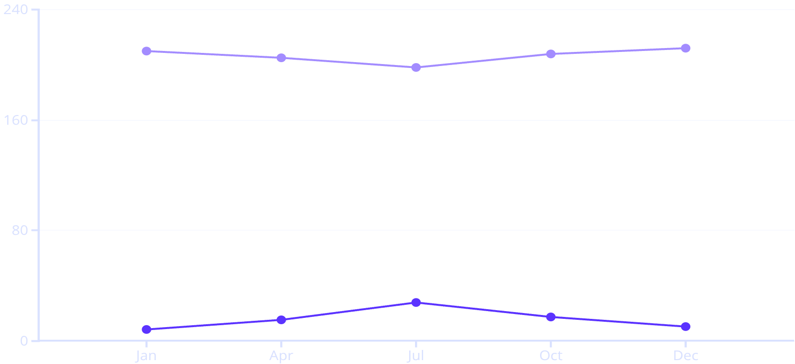

Temporal Patterns: Monthly CO & Temperature Trends
A line chart compares the monthly average CO levels and temperatures over the 12-month period of 2022. This visual is designed to explore the seasonal impact on both metrics and identify any temporal correlations or divergences.
The data clearly illustrates the seasonal nature of temperature, with peaks and troughs corresponding to summer and winter months. Conversely, Carbon Monoxide levels exhibit relative stability, with only small, often localized, variations throughout the year.
Analyzing these trends helps environmental analysts understand if CO pollution is driven by immediate weather changes or by constant, year-round human activities.
Average Temp (°C)
Average CO (ppb)

Slide 9




Synthesis: Drawing Conclusions from Visual Data
By integrating the geographical and temporal visualizations, we can extract several critical insights regarding the global environmental state in 2022. The combination of maps and trends provides a powerful context for understanding the data.
Geographic Variability
Temperature is highly dependent on season and latitude, showing expected climatic ranges across the world.
Pollution Hotspots
CO levels vary significantly between countries, pointing to localized sources of pollution and the need for targeted policies.
Observable Patterns
While direct causation is not established, the visualization of both maps and the monthly trend line provides compelling patterns for further, deeper investigation.
Contextual Strength
The combination of spatial (maps) and temporal (trends) data offers a robust framework for environmental context and analysis.

Slide 10


Next Steps: Addressing Limitations and Expanding Analysis
While the initial project provided valuable insights, there are inherent limitations in using country-level averages. Future iterations will focus on expanding the scope of pollutants and refining the level of detail provided to users.
Current Limitations
Future Improvements
Country averages can mask important city-level variation and local extremes.
Incorporate critical pollutants such as PM2.5, NO2, and O3 to broaden the scope of the air quality index.
The analysis was limited to only two pollutants (CO and TEMP), which restricts a holistic view of air quality.
Develop new visuals, including correlation matrices and ranking charts, to highlight relationships between variables.
Implement granular region and city-level filters in the dashboard for more localized insights and targeted policy action.

